Slide 1
SAP ERP
Software

Slide 2
Points to Discuss
What is ERP & SAP
History of SAP & What makes SAP Different
Roles in SAP
SAP Modules
Benefits of SAP
ERP and SAP Market share

Slide 3

typical enterprise business process
Warehouse
Finance Department
Sales Department
Production Department
I ordered KIA car
Logistic Department

Slide 4
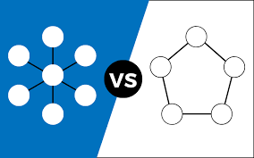
Difference between centralized and decentralized System

Slide 5

Various erp packages available in the market
SAP
Oracle E-Business Suite Financials and PeopleSoft Enterprise.
Baan ERP software
Microsoft
Workday
Deltek etc

Slide 6
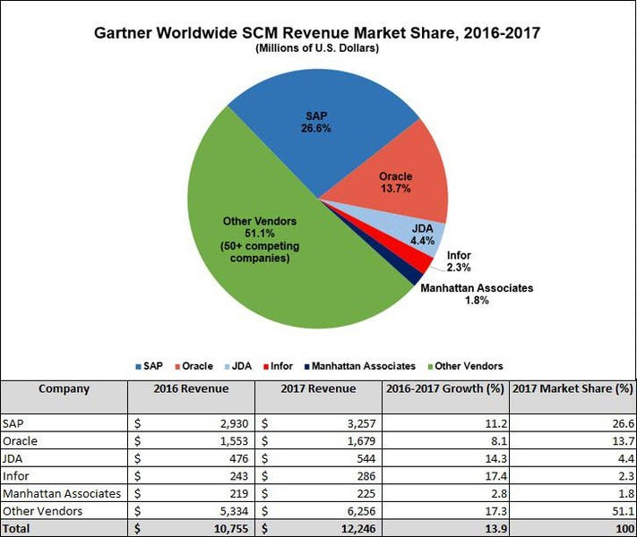

Slide 7
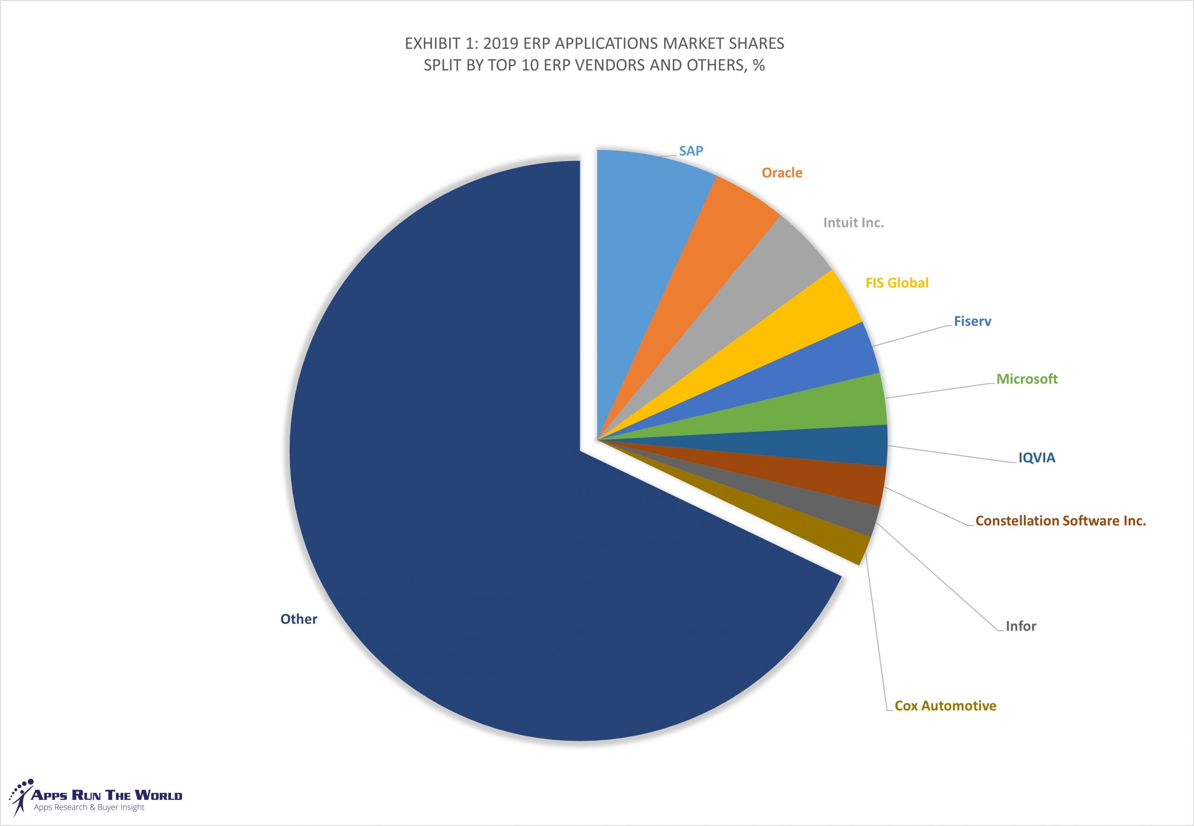
Market forecast 2019 - 2024

Slide 8
INTRODUCTION``
SAP was founded by five IBM Germen employees. Founded in 1972, the company was initially called System Analysis Program Development later abbreviated to SAP.
ERP : stands for Enterprise Resource Planning. It integrates all the systems in one system. It facilitates free flow of data among departments.

Slide 9
Details of SAP versions
R/1 and R/2
R/3 - 3 Tier Architecture- SAP R/3 is an ERP standard software developed by SAP and released in 1992. Presentation(using any device), application(inputs), data base( store)
ECC-SAP ERP Central Component. It's one of SAP legacy applications that originally designed to operate on a third-party database such as Oracle and IBM DB2. Simplifications from accounting point (New GL)
SAP S/4 HANA- SAP business Suite for SAP HANA. New database (HANA) for faster execution, new & Improved functionalities, HANA is SAP's own in-memory database

Slide 10
2108- innovation
Intercompany document matching (leveraging machine learning),
Automatic Invoice deferrals based on purchase order reference information,
Event based revenue recognition and Margin analysis,
New payment advice engine,
Group planning- FI planning for P&L & B/S planning

Slide 11
Roles In sap
SAP
SAP Consultant for Implementing software
SAP
SAP End User
SAP
SAP Support Team
SAP
SAP ABAP- Advanced Business Application Programming (ABAP) is a programming language that simplifies the development of business applications (Coding)
SAP
SAP BASIS- Responsible for providing technical support on SAP basis systems. These consultants are required to design and implement solutions that are comprised of the installation and configuration.

Slide 12
Structure of Core Team
Purchaser ARTI Module Implementor CG
1. Accounts Manager FICO 1) FI Consultant
2. Costing Manger FICO 2) CO Consultant
3. Purchase Manager MM 3) MM Consultant
4. Sales Manager SD 4) SD Consultant
5. IT Staff Implementation 5) Basis Consultant
6.Project Manager Oversee Project 6)ABAP Programmer
pushpa 7) Project Manager Ram

Slide 13
SAP Application Modules
Financial Accounting
Controlling
Material Management
Sales and distribution
Logistic Execution
Production Planning etc

Slide 14
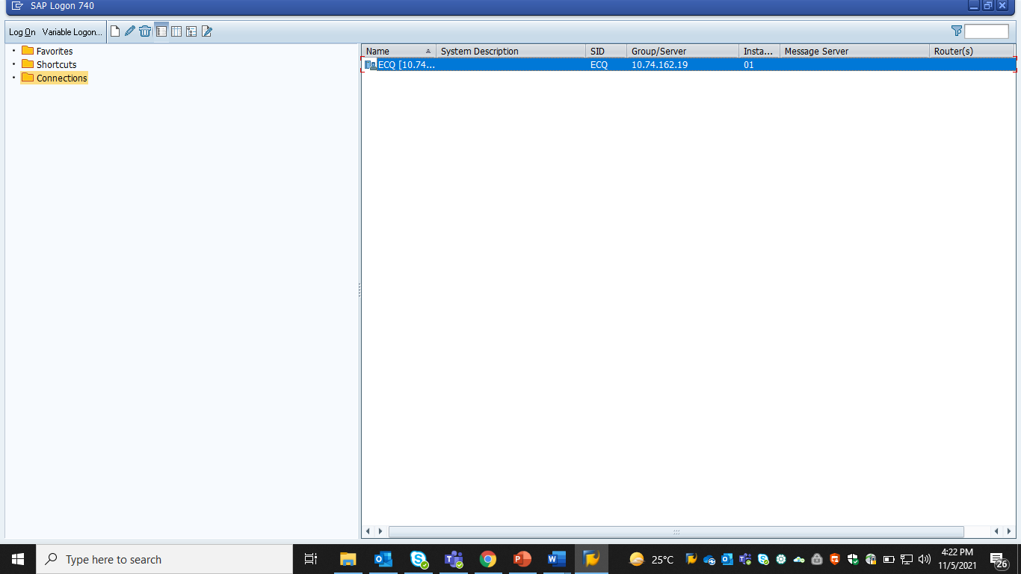

Slide 15
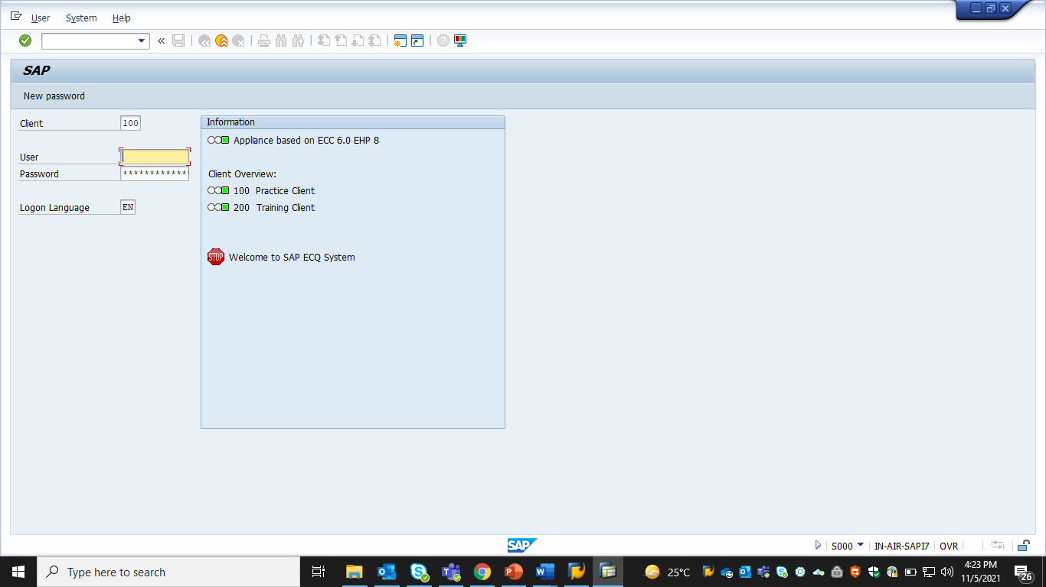

Slide 16
What is Client # ?
In the SAP landscape, a client is an entity with independent information and data. ... SAP provides the option of allocating each customer to a client, thereby removing the need to provide separate physical systems for each customer.
SAP Client is the highest hierarchical organizational unit within an SAP system that contains master records and tables. The transactions processed at SAP client level is valid and applicable for all company code data and enterprise structures. ... The data entered at client level is valid for all organizational units.

Slide 17
FI Organizational structure?
Client
Operating Concern
Controlling area1 Controlling Area 2
Co. Code 1 Co. Code 2
Bus area 1 Bus area2 Bus Area3 Bus Area 4

Slide 18
Supported LANGUAGE
SAP Language Packs can translate your SAP system into as few or as many of the 40 supported languages as you need

Slide 19
Important points about Username & Password
It is not possible to change the password more than once in a day
System will not permit us to use the latest 5 passwords.
If we forgot Password, it can not be restored. Basis Consultant will allot New Password.

Slide 20
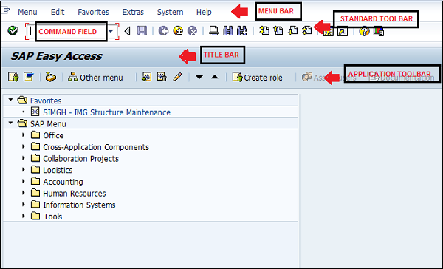

Slide 21
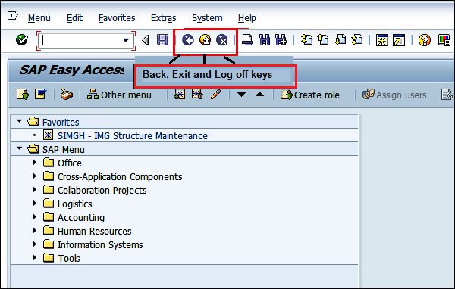
Other

Slide 22
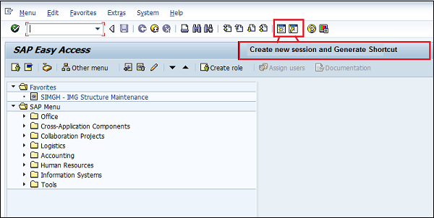

Slide 23
WHAT IS SESSION
A session is a window or screen where SAP user will do day to day activities.
One user can open 6 Sessions at a time.
Forward /n-switch
Forward /o- open new
Ctrn +n

Slide 24
ACTIVATING TRASACTION CODES IN SAP MENU
If T-Code will not appear in SAP Easy Access Menu.
To activate them path is
Menu Bar---->Extras---->Settings---->Display Technical Names Check Box and Press Enter

Slide 25
Thank you

